Slide 1
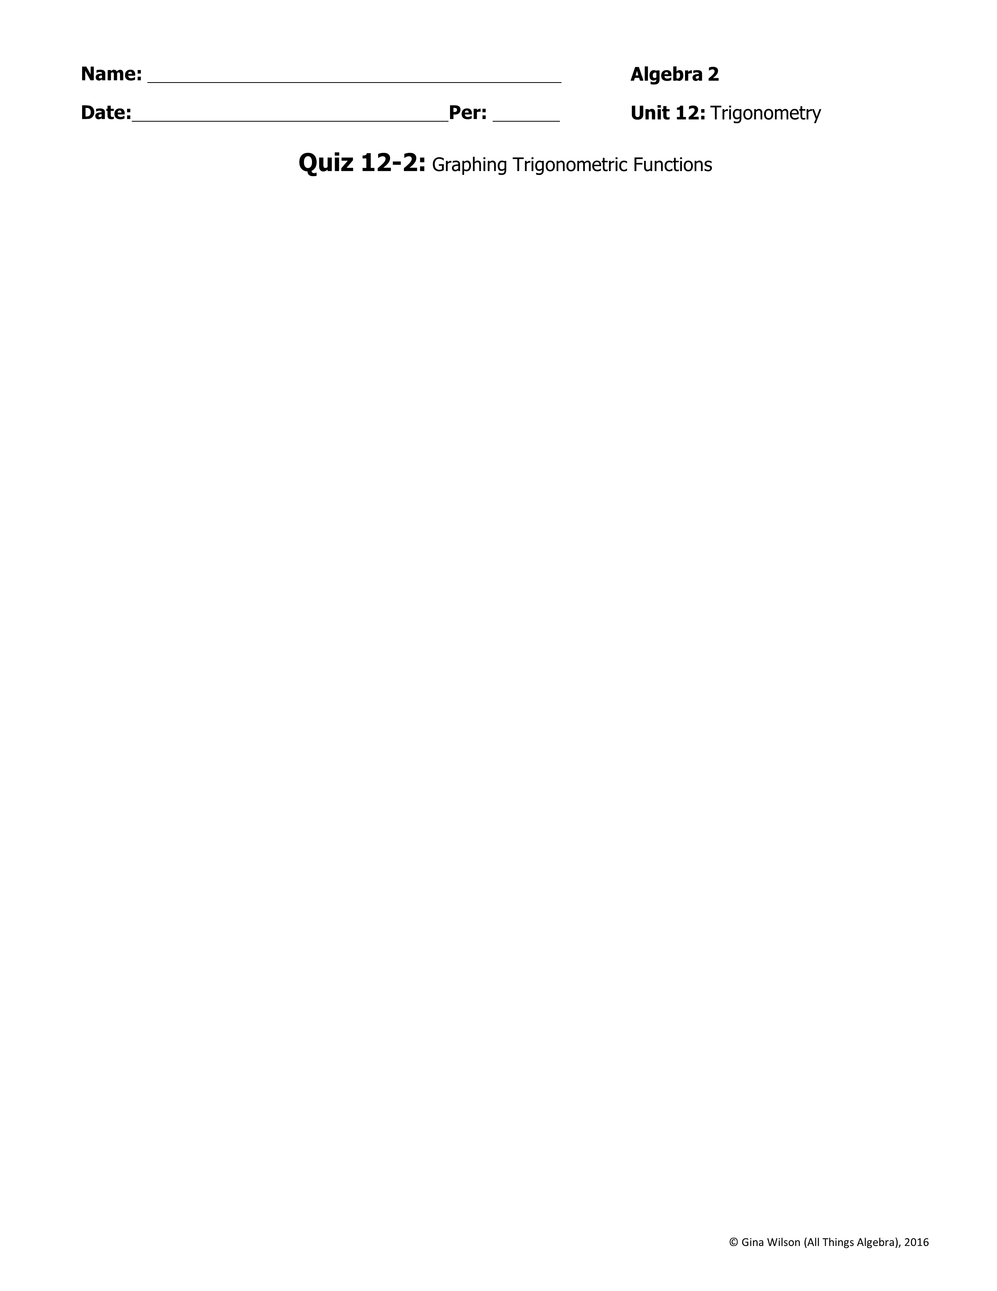
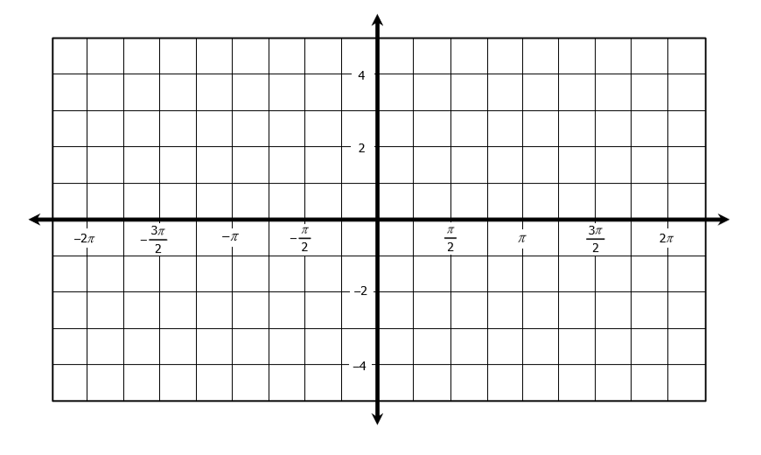
Directions: Identify the amplitude, if possible, and period for each function. Then graph.
1.
Amp: __________ Per: _________
2.
Amp: __________ Per: _________
3.
Amp: __________ Per: _________
4.
Amp: __________ Per: _________
5.
Amp: __________ Per: _________
6.
Amp: __________ Per: _________

Slide 2

7.
Amp: __________ Per: _________
8.
Amp: __________ Per: _________
9.
Amp: __________ Per: _________
10.
Amp: __________ Per: _________
Directions: Identify the amplitude, if possible, period, translations, and midline. Then graph.
11.
Amplitude: ________________
Period: ________________
Phase Shift: ________________
Vertical Shift: ______________
Midline: _______________
12.
Amplitude: ________________
Period: ________________
Phase Shift: ________________
Vertical Shift: ______________
Midline: _______________

